Slide 1



















Tahaluf Copyright 2022- All Right Reserved
Harmony IT Solution
learning Hub
Web Application Programming Interface (API)
Tahaluf Training Center 2022

Slide 2



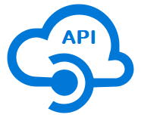





Tahaluf Copyright 2022- All Right Reserved
Harmony IT Solution
1
Overview of External API
2
The Differences Between external API and Internal API
3
Weather external API
4
4
Getting Data from Multiple Tables in Web API
5
4
7
6
8
8
9

Slide 3










Tahaluf Copyright 2022- All Right Reserved
Harmony IT Solution
Overview of External API

Slide 4
Tahaluf Copyright 2022- All Right Reserved
Harmony IT Solution
The main characteristics of external API activity are the Ability to fetch data in a JSON format file to a 3rd party restful API endpoint.
Ability to receive and save a JSON response back, map it to output tables, and pass it downstream to other workflow activities.

Slide 5
Tahaluf Copyright 2022- All Right Reserved
Harmony IT Solution
Limitations of External API:
5MB HTTP response data size limit.
HTTP redirects are not allowed.
Request timeout is 1 minute.
Non-HTTPS URLs are rejected.

Slide 6
Tahaluf Copyright 2022- All Right Reserved
Harmony IT Solution
The Differences Between external API and Internal API

Slide 7
Tahaluf Copyright 2022- All Right Reserved
Harmony IT Solution
Internal APIs VS External APIs
One of the most important things that you should consider in both your interface architecture and API business strategy is the difference between internal and external API. An interface can be described as internal and external depending on whether its target is for in-house or external developers.

Slide 8
Tahaluf Copyright 2022- All Right Reserved
Harmony IT Solution
Internal APIs VS External APIs
Is an API designed for access by a larger population as well as web developers. This implies that an external API can be easily used by developers inside the organization (that published the API) and any other developers from the outside who desires to register into the interface.

Slide 9
Tahaluf Copyright 2022- All Right Reserved
Harmony IT Solution
Weather external API

Slide 10
Tahaluf Copyright 2022- All Right Reserved
Harmony IT Solution
Overview of Weather external API
OpenWeather provides historical, current and forecasted weather data via light-speed APIs.
Before doing anything, you need an API key. Go to the Signup page.

Slide 11
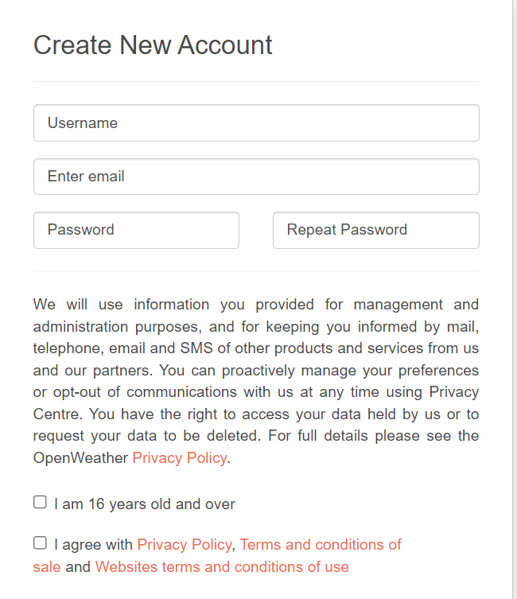
Tahaluf Copyright 2022- All Right Reserved
Harmony IT Solution

Slide 12
Tahaluf Copyright 2022- All Right Reserved
Harmony IT Solution
Overview of Weather external API
The API key will send to you via email and may be found on the API keys page (under your account).
In order to display the current weather for any city using the weather API on openweathermap.org

Slide 13
Tahaluf Copyright 2022- All Right Reserved
Harmony IT Solution
Create Weather controller:
[HttpGet("weather/{city}")]
public async Task<Weather> City(string city)
{
using (var client = new HttpClient())
{
var response = await client.GetAsync($"http://api.openweathermap.org/data/2.5/weather?q={city}&appid=511ba00e6b1fdebcf7456541e7a16390");
var stringResult = await response.Content.ReadAsStringAsync();
var weatherResult = JsonConvert.DeserializeObject<Weather>(stringResult);
return weatherResult;
}
}
Notes:
[HttpGet("weather/{city}")]
public async Task<Weather> City(string city)
{
using (var client = new HttpClient())
{
var response = await client.GetAsync($"http://api.openweathermap.org/data/2.5/weather?q={city}&appid=511ba00e6b1fdebcf7456541e7a16390");
var stringResult = await response.Content.ReadAsStringAsync();
var weatherResult = JsonConvert.DeserializeObject<Weather>(stringResult);
return weatherResult;
}
}

Slide 14
Tahaluf Copyright 2022- All Right Reserved
Harmony IT Solution
In TahalufLearn.core => DTO => Create a class for Weather:
namespace TahalufLearn.core.DTO
{
public class Main
{
public string Temp { get; set; }
public string humidity { get; set; }
}
public class Wind
{
public string speed { get; set; }
}
Notes:
using System;
using System.Collections.Generic;
using System.Text;
namespace TahalufLearn.core.DTO
{
public class Main
{
public string Temp { get; set; }
public string humidity { get; set; }
}
public class Wind
{
public string speed { get; set; }
}
public class Weather
{
public Main main { get; set; }
public Wind wind { get; set; }
public string name { get; set; }
public string timeZone { get; set; }
}
}

Slide 15
Tahaluf Copyright 2022- All Right Reserved
Harmony IT Solution
public class Weather
{
public Main main { get; set; }
public Wind wind { get; set; }
public string name { get; set; }
public string timeZone { get; set; }
}
}

Slide 16
Tahaluf Copyright 2022- All Right Reserved
Harmony IT Solution
Getting Data from Multiple Tables

Slide 17
Tahaluf Copyright 2022- All Right Reserved
Harmony IT Solution
To retrieve each category and their courses:
In Course_Package Create GetAllCategoryCourse Proceadure:
create or replace PACKAGE Course_Package AS
PROCEDURE GetAllCategoryCourse;
END Course_Package;

Slide 18
Tahaluf Copyright 2022- All Right Reserved
Harmony IT Solution
create or replace PACKAGE Body Course_Package
as
PROCEDURE GetAllCategoryCourse
AS
c_all sys_refcursor;
BEGIN
OPEN c_all FOR
SELECT cat.categoryid, cat.categoryName , C.CourseId , C.CourseName
FROM Course C
INNER JOIN category cat
ON c.categoryid = cat.categoryid;
DBMS_SQL.RETURN_RESULT(c_all);
END GetAllCategoryCourse;
END Course_Package;

Slide 19
Tahaluf Copyright 2022- All Right Reserved
Harmony IT Solution
In TahalufLearn.Core => Reopsitory => ICourseRepository => Create GetAllCategoryCourse:
Task<List<Category>> GetAllCategoryCourse();

Slide 20
Tahaluf Copyright 2022- All Right Reserved
Harmony IT Solution
In TahalufLearn.Infra => Reopsitory => CourseRepository => Create GetAllCategoryCourse:
public async Task<List<Category>> GetAllCategoryCourse()
{
var p = new DynamicParameters();
var result = await dBContext.Connection.QueryAsync<Category, Course, Category>("Course_Package.GetAllCategoryCourse",
(Category, course) =>
{
Category.Courses.Add(course);
return Category;
},

Slide 21
Tahaluf Copyright 2022- All Right Reserved
Harmony IT Solution
splitOn: "Courseid",
param: null,
commandType: CommandType.StoredProcedure
);
var results = result.GroupBy(p => p.Categoryid).Select(g =>
{
var groupedPost = g.First();
groupedPost.Courses = g.Select(p => p.Courses.Single()).ToList();
return groupedPost;
});
return results.ToList();
}

Slide 22
Tahaluf Copyright 2022- All Right Reserved
Harmony IT Solution
In TahalufLearn.Core => Service => ICourseService => Create GetAllCategoryCourse:
Task<List<Category>> GetAllCategoryCourse();

Slide 23
Tahaluf Copyright 2022- All Right Reserved
Harmony IT Solution
In TahalufLearn.Infra => Service => CourseService => Create GetAllCategoryCourse:
public Task<List<Category>> GetAllCategoryCourse()
{
return courseRepository.GetAllCategoryCourse();
}

Slide 24
Tahaluf Copyright 2022- All Right Reserved
Harmony IT Solution
In TahalufLearn.API => Controller => CourseController => Create GetAllCategoryCourse:
[HttpGet]
[Route("GetAllCategoryCourse")]
public Task<List<Category>> GetAllCategoryCourse()
{
return courseService.GetAllCategoryCourse();
}

Slide 25
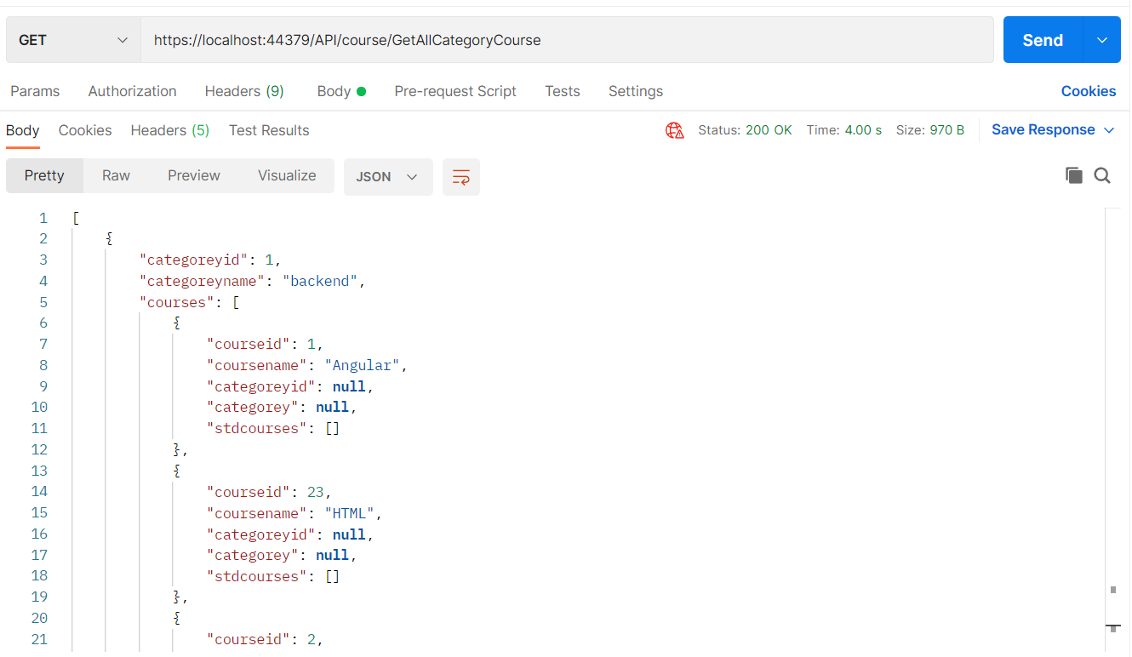
Tahaluf Copyright 2022- All Right Reserved
Harmony IT Solution
The Result on postman:

